Slide 1
Fluid Machines
Rudra Mani Ghimire

Slide 2
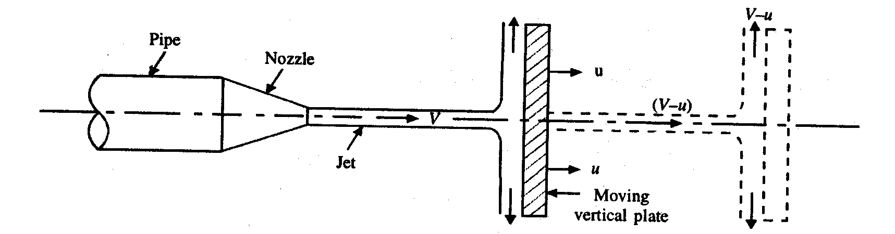
B. FORCE EXERTED BY THE JET ON THE MOVING PLATE 5. FORCE EXERTED ON A MOVING FLAT PLATE HELD NORMAL TO JET
A fluid jet striking a flat vertical plate moving with a uniform velocity away from the jet.
V = absolute velocity of the jet,
a = cross-sectional area of the jet, and .
u = velocity of the flat plate held normal to the jet.
Fig. 17•7. Fluid jet striking a moving plate.

Slide 3
B. FORCE EXERTED BY THE JET ON THE MOVING PLATE 5. FORCE EXERTED ON A MOVING FLAT PLATE HELD NORMAL TO JET
Fx = ρa(V- u) (V_{x1}-V_{x2})
= ρa(V- u) [V- u) – O]
= ρa (V-u)²
W =ρ a (V - u) ² u
This case is not practically feasible because the distance between the nozzle and the plate will go on increasing. However, if a series of plates is fitted on the wheel, there is always a plate facing the jet. Thus the entire fluid issuing from the jet strikes the plates.

Slide 4
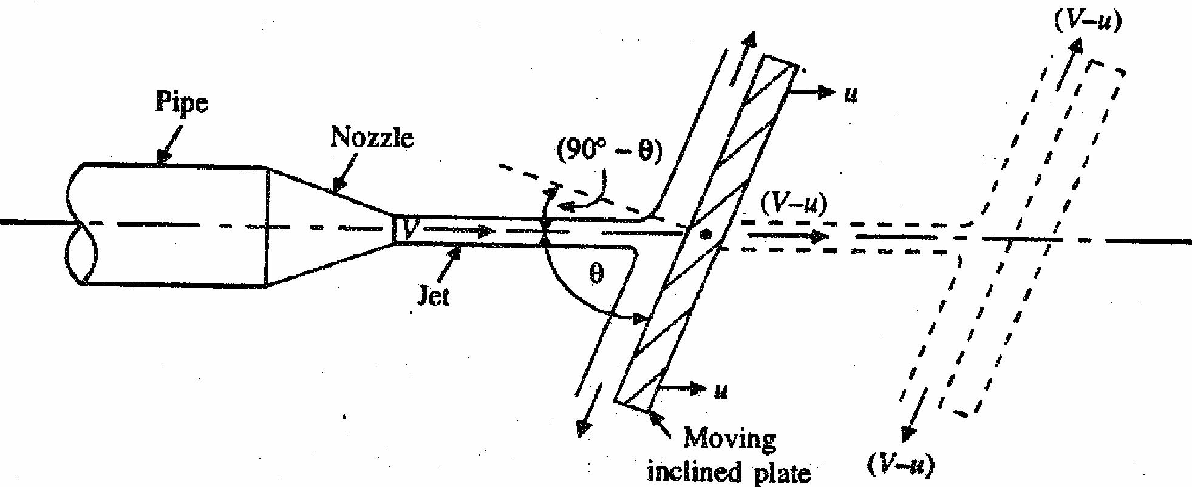
Force Exerted on a Moving Plate held Inclined to the Direction of Jet:
A fluid jet striking an inclined plate, which is moving with uniform velocity in the direction of the jet.
Fig. 17•8. Fluid jet striking a moving plate held inclined to the direction of jet.
Fn = ρ a (V - u) [(V - u) sin θ- 0]
Fn = ρ a (V- u)² sin θ
FX=Fnsinθ =ρ a (V- u)2 sin θ sin θ
= ρ a (V- u)² sin²θ
Work done = FX u = u ρ a (V- u)² sin²θ

Slide 5
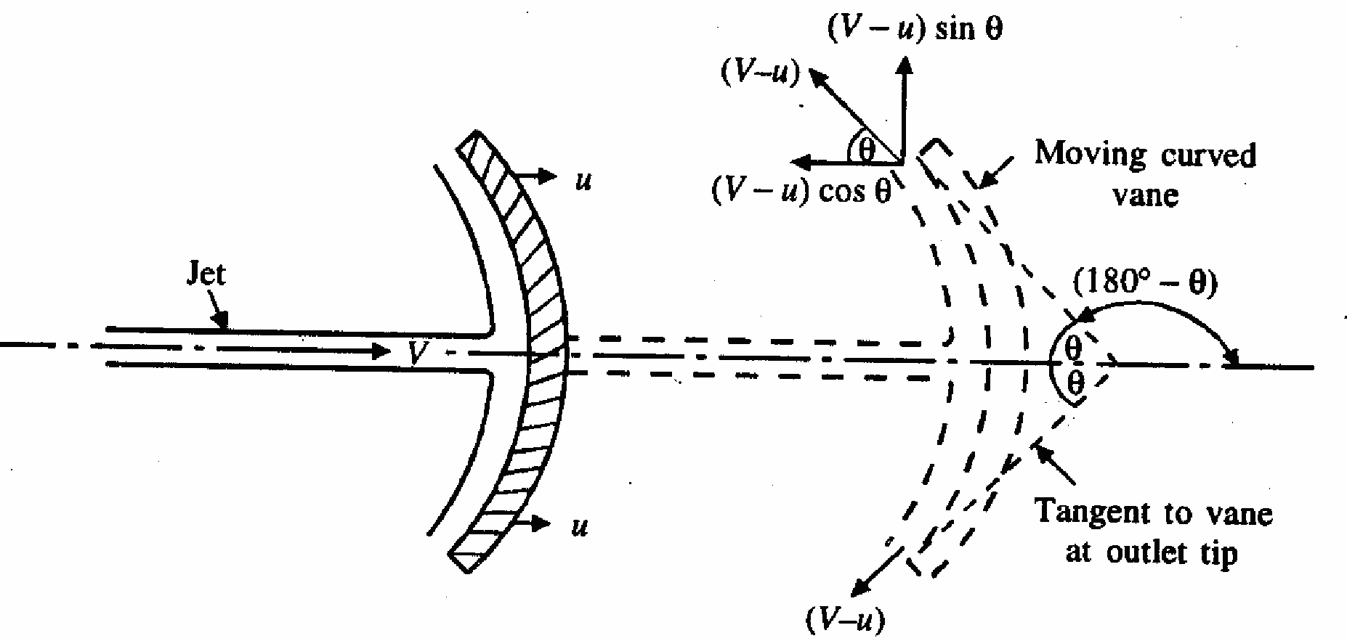
7. Force Exerted on a Curved Plate (or Vane) when the Plate (or Vane) is Moving in the Direction of Jet. 7.1 Single Vane
A fluid jet striking at the centre of curved vane moving with a uniform velocity in the direction of jet.
Fx= ρa (V- u) [(V- u) - {- (V- u) cos θ}]
= ρa(V-u)2 (l+cosθ)
Wx = u ρa(V-u)2 (l+cosθ)

Slide 6
Kinetic energy of issuing jet = 1/2 (mV ²) = 1/2(ρaV) V²
= 1/ 2 ( ρ aV³ )
Efficiency,= η = work done________________________
kinetic energy supplied by the jet
= u ρa(V-u)2 (l+cosθ)
1/ 2 ρ aV³
= 2 u (V-u)2 (l+cosθ)
V³
For a given jet velocity, the efficiency will be maximum when dη / du =0
d [ 2 u (V-u)2 (l+cosθ) ] = 0
du V3
2 × (1+cos θ) d [ (v-u) 2 ×u ] = 0
v3 du
2 × (1+cos θ) d [ (uv2+ u3 -2vu2) ] = 0
v3 du
2 × (1+cos θ) [ (v2+ 3u2 -4vu) ] = 0
v3
2 × (1+cos θ) ≠ 0
v3
(v2+ 3u2 -4vu) = 0
(v-u) (v-3u) = 0; u = V or u = V/ 3
When u = V, the work done becomes zero. Thus for maximum efficiency u = V/3 i.e. vane velocity is 1/3 rd of the jet velocity.

Slide 7
Series of Vanes:
In this case, there is always one vane or the other facing the jet (e.g. curved vanes mounted equidistantly around the periphery of a wheel) and the entire fluid is utilized.
Fx = ρaV [(V- u) - (- (V- u) cos θ) } ]
= ρaV [(V - u) + (V - u) cos θ)]
= ρaV (V - u) (1 + cos θ)
Wx = Fx × u= paV (V- u) (1 +cos θ) x u
Kinetic energy supplied by the jet
= 1/2 (paV)V2 =1/2 (paV³)
Efficiency,= η = work done
kinetic energy supplied by the jet
= u ρaV (V - u) (1 + cos θ)
1/ 2 ρ aV³
= 2 u (V-u) (l+cosθ)
V²

Slide 8
For a given jet velocity, the efficiency will be maximum when dη / du =0
d [ 2 u (V-u) (l+cosθ) ] = 0
du V2
2 × (1+cos θ) d [ (v-u) ×u ] = 0
V2 du
2 × (1+cos θ) d [ (uv - u2) ] = 0
V2 du
2 × (1+cos θ) [ (v – 2 u) ] = 0
v3
2 × (1+cos θ) ≠ 0
V2
(V – 2u ) = 0
u = V/2
ηmax = 2 V/2 (V- V/2) (l+cosθ)
V2
= (l+cosθ)
2
When θ = 0 i.e. the vanes are semicircular, ηmax = 1 or 100% (theoretical).
The semi-circular vanes are designed of buckets for Pelton wheel. The buckets are, however not exactly semicircular. The angle of deflection is limited to 160°-170° depending upon a particular design. This ensures that the jet coming out of a bucket does not interfere with the jet striking the bucket.

Slide 9
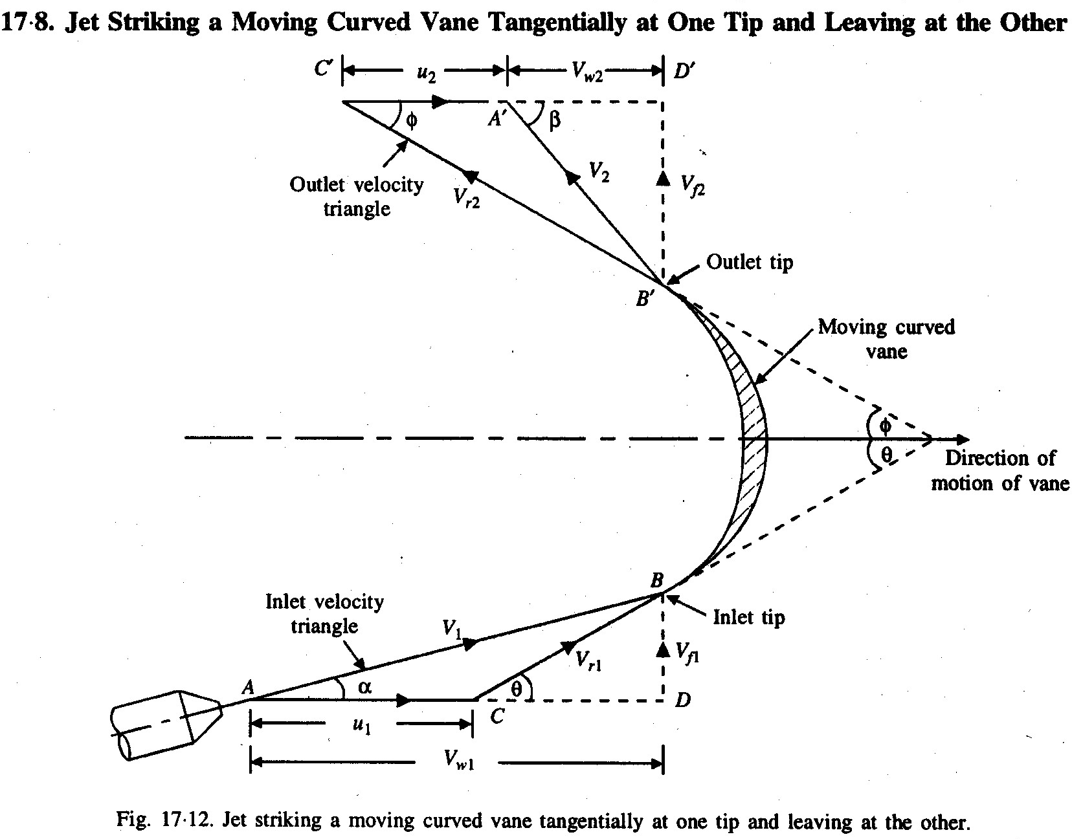

Slide 10
u1 = u2 = u (velocity in the direction of motion), and Vrl = Vr2
Fx = ρ a Vrl [ Vrx1 - Vrx2]
= ρ a Vrl [ Vrl COS θ - (- Vr2 COS φ) ]
= ρaVr1 [(Vwl - ul) - {-(u2+Vw2}]
= ρaVr1 [Vwl +Vw2]
The eqn. is true only when β is an acute angle. When β=90°,Vw2 = 0 the eqn. (i) reduces to Fx = ρaVr1 [Vwl ]
If β is an obtuse( greater than 90) angle, the expression for Fx will become
Fx = ρaVr1 [Vwl - Vw2]
Thus in general Fx is written as, Fx=ρaVr1 [Vwl ± Vw2]

Slide 11
Work done per second by the jet on the vane
= Fx × u =ρaV_{r1} [V_{wl} ± V_{w2}] × u
Work done per second per unit weight of fluid striking
= ρ a V_{rl} (V_{wl} ± V_{w2}) × u
Wt. Of the fluid striking
= ρ a V_{rl} (V_{wl} ± V_{w2}) × u
ρ a V_{rl} g
= 1/g (Vwl ± Vw2) × u

Slide 12
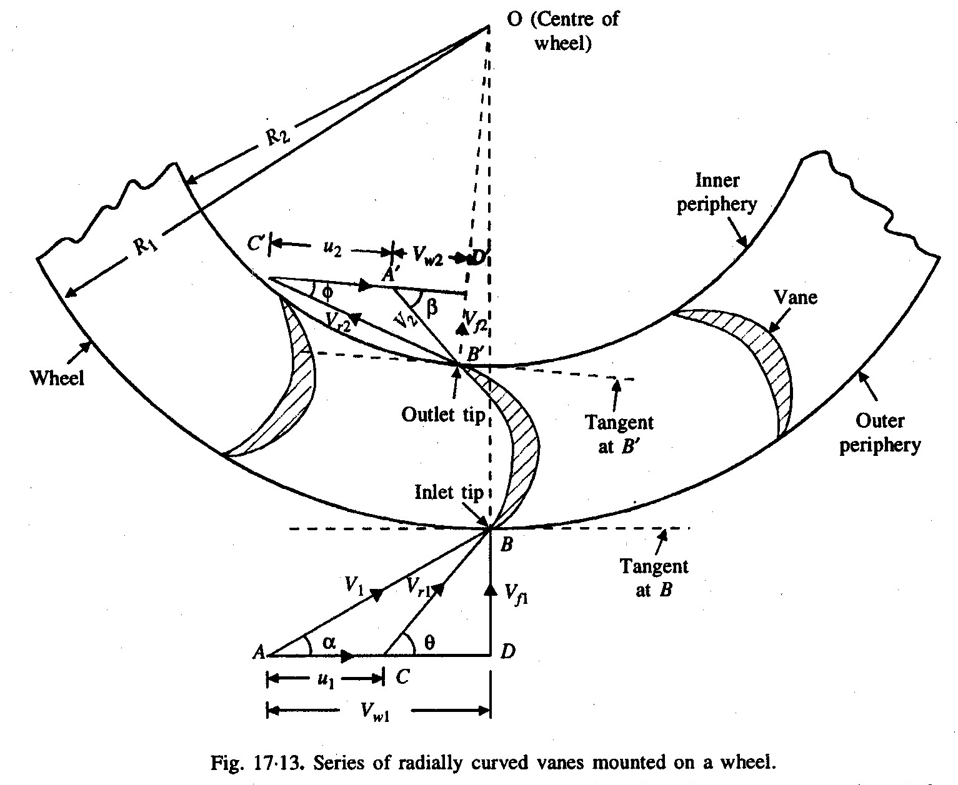
8.2 Force exerted on a series of radial curved vanes

Slide 13
Momentum of water striking the vanes (in tangential direction) per second at inlet = (ρaVl) × (-Vw1)
[where Vw1 (= Vl, cosθ} = component of Vl in the tangential direction.]
Similarly momentum of water per second at outlet = (ρaVl) × (-Vw2)
Angular momentum per second at inlet = momentum at inlet × radius at inlet =(ρaVl) × Vw l ×R1
Angular momentum per second at outlet = - (ρaV2) × Vw 2×R2
Torque exerted by water on the wheel,
T= rate of change of angular momentum
=(initial angular momentum per second-final angular momentum per second)
=(ρaVl) × Vw l ×R1 – [– (ρaV2) × Vw 2×R2]
=(ρaVl) ×[ Vw l ×R1 + Vw 2×R2]

Slide 14
Work done per second on the wheel = T ×ω
=(ρaVl) ×[ Vw l ×R1 + Vw 2×R2] ×ω
=(ρaVl) ×[ Vw l ×R1×ω + Vw 2×R2×ω]
=(ρaVl) ×[ Vw l ×u1 + Vw 2×u2] Because u1 = R1×ω and u2= R2×ω
=(ρaVl) ×[ Vw l ×u1 ± Vw 2×u2] is the general expression
-ve when β is obtuse and Vw 2 = 0 when β=90 °

Slide 15
Efficiency of the radial curved vane, ηvane :
= work done per second
kinetic energy per second
= (ρaV1) ×[ Vw1 × u1 ± Vw2 × u2]
(½ ρaV1 )V1 2
= 2×[ Vw1× u1 ± Vw 2 × u2]
V₁ ²

Slide 16
9. Jet Propulsion of Ships:
One of the applications of the impulse-momentum equation is `jet propulsion' wherein the reaction of a high velocity jet issuing from a nozzle provides the necessary thrust,
The principle is employed in propelling the ships, aircraft and missiles.
Case I When the inlet orifices are at right angles to the direction of the motion of the ship:
A ship which is having the inlet orifices at right angles to its direction.
The ship carries a centrifugal pump which takes water from the sea and discharges it through nozzle at the rear of the ship.
V= absolute velocity of the issuing jet, u = velocity of the moving ship
u = velocity of moving ship

Slide 17
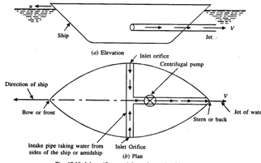

Slide 18
Propulsive force exerted on the ship,
Fx= mass flow rate of water × change in Jet velocity
= ρ a (V+ u)× (Vr –u) = ρ a (V+ u)× V
Thrust or propulsive work per second
= forward thrust x speed of ship= ρ a (V+ u)× V× u
As the intake is at right angles to the direction of motion, inlet velocity of water is zero; hence the outlet velocity equals V, and hence the kinetic energy supplied by the jet per second is
= ½ ρ a Vr× Vr2 == ½ ρ a(V+ u)3

Slide 19
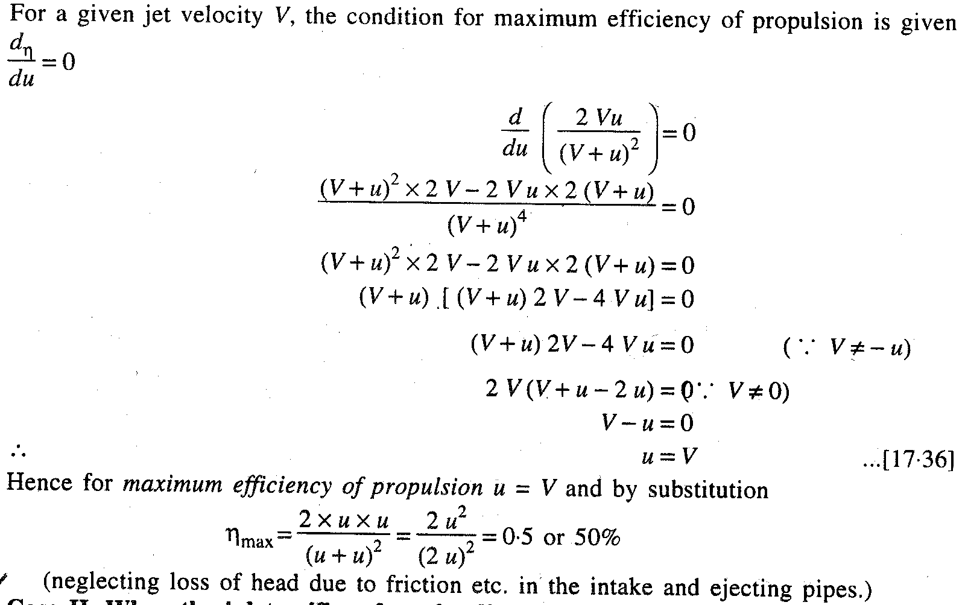

Slide 20
Case II When the inlet orifices face the direction of motion of the ship:
A ship which is having the inlet orifices facing the direction of the motion of the ship.
The water is drawn in by a longitudinal (intake) pipe from bow (front) of the ship and is discharged at the stern (back).
For this case the expression for propulsive force and work done per second will be the same as those for the case I i, e, when the inlet orifices are at right angles to the ship motion.
But the energy supplied by the jet will be different, as in this case the water enters with a velocity equal to the velocity of the ship (u).
Kinetic energy supplied by the jet = ½ ρ a Vr× (Vr2-u2) = ½ ρ a (V+u)× [(V+u)2-u2]

Slide 21
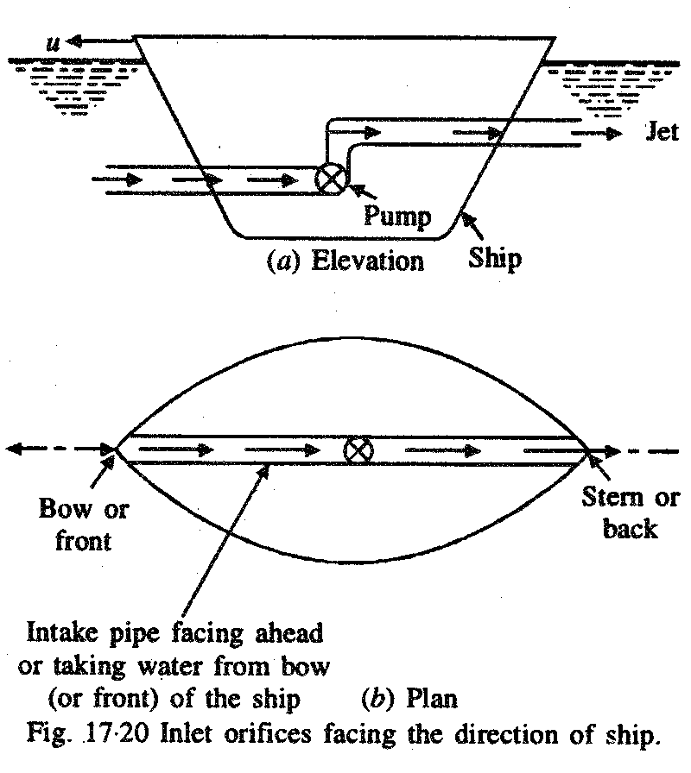

Slide 22
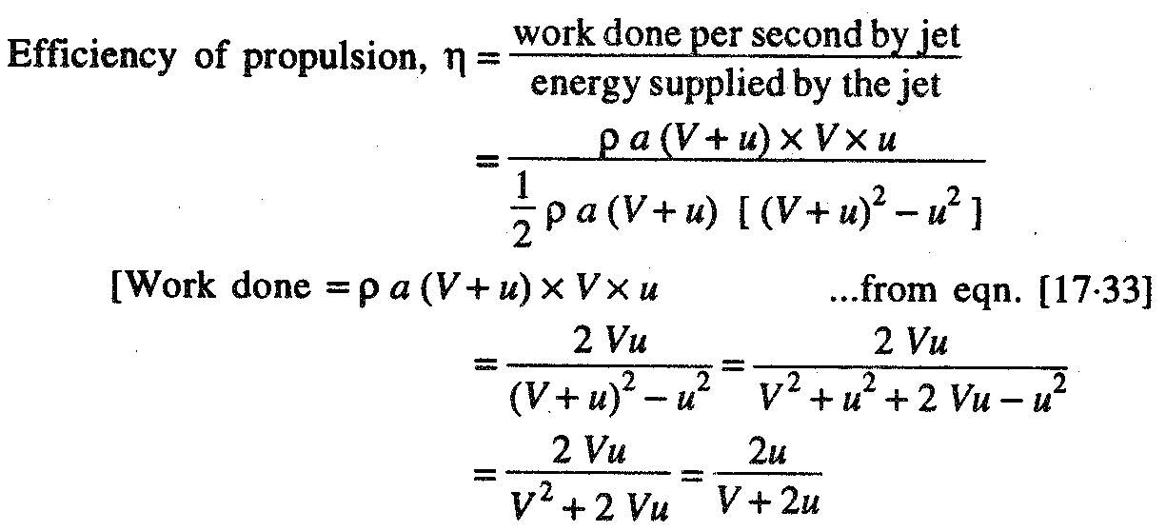

Slide 23
In this case, however it is not possible to derive a practical condition for maximum efficiency. But for u = V, which is the condition for the maximum efficiency in the previous case (i.e., case I), corresponding value of the efficiency for this case will be
η= 2u / (V+ 2u) = 2u / (u+ 2u ) = 2/3 = 0.67%
In actual practice, since the velocity of ship u will normally be less than the velocity of jet V, and therefore the limiting value of u is equal to V. Hence the above obtained value of the efficiency may be considered as the maximum possible efficiency for this case.
Note. The propulsion of ships is also known as water rocket. In practice jet propulsion is used only
in small life boats.
For large ships, the screw propulsion is generally preferred because of high
overall efficiency of screw propulsion.

